Slide 1
Introduction to Computer Systems
Department of Computer Science and Information Systems
Lecturer: Steve Maybank
sjmaybank@dcs.bbk.ac.uk
Spring 2020
Revision Class 2019-2020

Slide 2
About the Exam
Remote
Weight 80% (in-class test weight 20%)
Date: Friday 29th May 2020
Moodle Time: 14.00-18.00

Slide 3
About the Exam
Downloading the Answer Book: 30 mins
Completing answers: 3 hours
Uploading the Answer Book: 30 mins
Total: 4 hours (5 hours if you have an SSP)
Uploading is not possible after the deadlines

Slide 4
About the Exam
Open book – but no copying or collusion
9 questions, 100 marks
Marks awarded for understanding the material, correct working and sound arguments.

Slide 5
About the Exam
Download an Answer Book (Word) containing the questions
Write your answers in the Answer Book
Upload the Answer Book at the end of the examination.
PDF versions of the answer book and of the examination paper in the old style can be downloaded for reference.

Slide 6
About the Answer Book
Use Word if possible
If not then use a text editor such as Libre Office on Linux, Google Docs, TextEdit on Mac.
If possible, upload a Word version of the Answer Book
If not, then upload a PDF version of your answer file.

Slide 7
Check Word
Text formatting
Indentation
Lists
Insertion of images, diagrams or pictures
etc

Slide 8
Handwritten Answers
If there is no other way then take pictures or scans of your handwritten answers.
Option 1: Insert the pictures or scans in the Answer Book
Option 2: save the pictures or scans in a PDF file for uploading. Any uploaded file must be less than 100MB

Slide 9
Name the Answer Book
Do not put personal information in the Answer Book
Rename the Answer Book using your student number, e.g. SN12345678ICS.docx

Slide 10
Hardware and Environment
Use an adequate machine
Obtain a reliable broadband connection
Consider a back up connection, e.g. Mi-Fi device or dongle (aka pocket WiFi) or a tether to a mobile Phone.
Find a comfortable quiet room
Print out the questions if it helps

Slide 11
In Case Things Go Wrong
If uploading fails, then send your file as an attachment to submit@dcs.bbk.ac.uk
For technical queries contact ITS, e.g.
logging into Moodle
scanning handwritten work
email: sd@its.bbk.ac.uk
phone: 020 3926 3456

Slide 12
Prepare for the Exam
Study the lecture slides
Check the syllabus: week 1b and weeks 2-8
Refer to the book: Computer science: an overview.
Study past papers: check the electronic library and the ICS web page.

Slide 13
ICS Syllabus Week 1b
Definition of an algorithm
Variables, q = 5
Algorithms for quotient and remainder, 25 = 3*7+4

Slide 14
Week 2a (Representations of Integers)
Powers of 10
Decimal representation of integers
381= 3*100+8*10+1
Powers of 2
Binary representation of integers,
1101 = 1*8+1*4+0*2+1
Powers of 16
Hexadecimal representation of integers,
A5F = 10*256+5*16+15

Slide 15
Week 2a (Continued)
Addition:
1101+1 = 1110
Multiplication:
1101*11 = 1101*(10+1)
= 1101*10+1101*1
= 11010+1101
= 100111

Slide 16
Week 2b (Excess and TC)
Excess notation
1-> add 4 ->101
Two’s complement notation
1->rightmost three bits of 2^(3)+1 = 001
-1->rightmost three bits of 2^(3)-1 = 111
TC and subtraction

Slide 17
Week 3a, Boolean Operations
>, >=, ==, !=, <, <=
Truth values
Truth tables (AND, OR, NOT)
Combinations of Boolean operations
NOT(A OR B)
NOT(A) AND NOT(B)

Slide 18
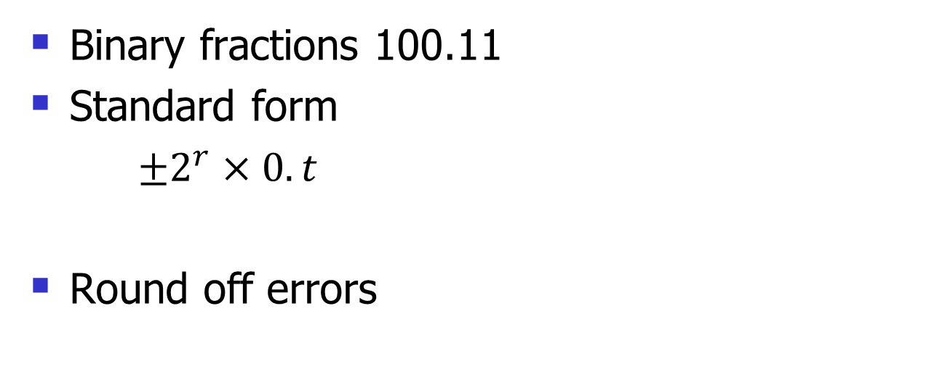
Week 3b (Floating Point)
Binary fractions 100.11
Standard form
$±2^{r}×0.t$
Round off errors

Slide 19
Week 4a (Hardware)
Hard disk, tracks, sectors
Seek time, latency, access time
Data rate
Compact Disk
Magnetic tape, flash memory, RAM

Slide 20
Week 4a (Continued)
Computer Architecture
Von Neumann bottleneck
Machine cycle

Slide 21
Week 5b (Instructions)
Types of instruction 156C, 256C
Op code 7 (OR)
Machine language
Machine cycle

Slide 22
Week 6b (Arrays)
Definition of an array
Two dimensional array
Array indexing
Address polynomial
5x5 array A, A[i, j] stored at x+5*i+j
Algorithms involving arrays

Slide 23
Week 7a (Pointers)
Definition of a pointer
Definition of a linked list
Add an element to a linked list
Remove an element from a linked list
Pseudo code for pointers
f1.data = 5,
f1.pointer = memory address 10011011

Slide 24
Week 7b (File Management)
Sequential file
Merging of sequential files
Index file
Hash file
Hash function
Bucket
Collision

Slide 25
Week 8a (Pseudo Code)
Assignment
Conditional selection
Repeated execution
Function
Parts of a function

Slide 26
Week 8b (Algorithm Design)
Bottom up design
Top down design
Search a sorted list
Iteration, sqrt(2)
Ferry problem

