Slide 1
Introduction to Programming
Department of Computer Science and Information Systems
Lecturer: Steve Maybank
sjmaybank@dcs.bbk.ac.uk
Autumn 2019 and Spring 2020
Week 3: Arithmetic and Built in Functions

Slide 2
Overview
Review of week 2:
number types
creating variables
Arithmetical problems
Arithmetic
Built in functions
See Python for Everyone, Ch. 2.2

Slide 3
Recall Number Types
Type int: whole numbers, positive, zero and negative, e.g. 1, 0, -1.
Type float: decimal fractions, e.g. 1.28, 3.0, -2.5, 0.0.
Warning: a number literal such as 1.3 cannot be represented exactly in a running program. Instead, the program uses a number of type float very near to 1.3.
PFE Section 2.1
3

Slide 4
Recall Creation and Initialisation of Variables
cansPerPack = 6
# create the variable cansPerPack and
# initialise it with the value 6 of type int
cansPerPack = 8
# overwrite the previous value 6 with the new value 8
cansPerPack = 8.5
# The values of cansPerPack can be switched from type
# int to type float and conversely
PFE Section 2.1
4

Slide 5
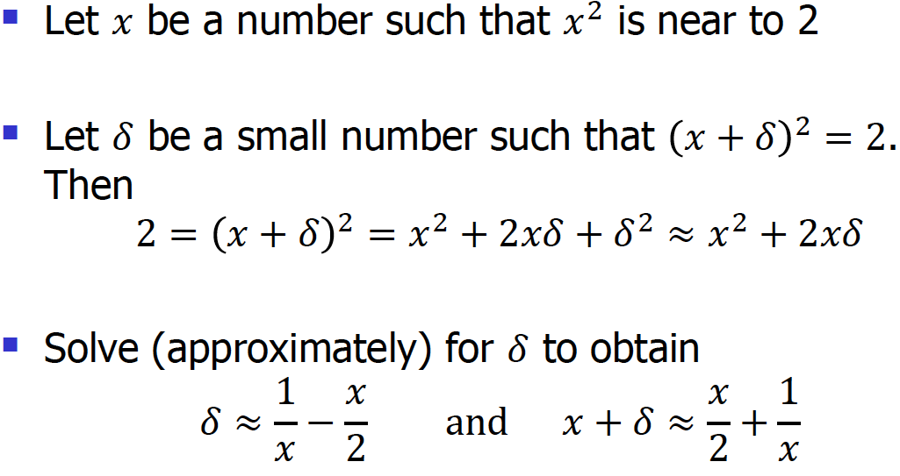
Square Root of 2
5
Notes:
sqrt 2 is an irrational number
the slide refers to the problem of finding the square root of 2 in the week 2 lab class. The strategy is to begin with an approximation x to the square root of 2 and then to find a better approximation x+delta. Then the process iterates, with x+delta in place of x.
I know that this slide will go over the heads of most students in the class, but I want to include it because of the importance of the concepts of approximation and iteration.
Let x=1.4 x^2=1.96 which is near to 2.
delta=1/1.4-1.4/2=0.01428571
x+delta=1.41428571
let x=x+delta.
>>>x=1.4
>>>x=x/2+1/x
>>>x
>>> 1.41428571
>>> x**2
2.000204069510204
>>>x=x/2+1/x
>>> x**2
2.000000005205014
>>> x=x/2+1/x
>>> x**2
1.9999999999999996
>>>

Slide 6
Square Root of 2
>>> x=1.4
>>> x**2
1.9599999999999997
>>> x=x/2+1/x
>>> x
1.4142857142857141
>>> x**2
2.0002040816326527
>>> x=x/2+1/x
>>> x
1.4142135642135643
>>> x**2
2.000000005205633
>>> x=x/2+1/x
>>> x
1.414213562373095
>>> x**2
1.9999999999999996
Find square root of 2:
Begin with an approximation x to the square root of 2
Find a better approximation x + δ
The process iterates, with x + δ in place of x

Slide 7
Problem Statement
You have the choice of buying two cars.
One is more fuel efficient than the other, but also more expensive.
You know the price and fuel efficiency (in miles per gallon, mpg) of both cars.
Assume a price of £4 per gallon of petrol and usage of 15,000 miles per year.
You plan to keep the car for 10 years.
You will pay cash for the car and not worry about financing costs.
Which car is the better deal?
PFE Section 1.7
7

Slide 8
Problem Break Down
1st stage
Find the total cost for each car
Choose the car that has the lowest total cost
2nd stage: total cost of a car (£) = purchase price (£) + operating cost (£)
3rd stage: operating cost (£)
= number of years to run * annual fuel cost (£)
4th stage: annual fuel cost (£)
= price per gallon (£/gal) * annual fuel consumed (gal)
5th stage: annual fuel consumed (gal)
= annual miles driven (miles) / fuel efficiency (miles/gal)
PFE Section 1.7
8

Slide 9
Description of Each Step
The descriptions are in pseudocode. The steps are ordered such that each step can be carried out using the results of previous steps
for each car, compute the total cost as follows
annual fuel consumed = annual miles driven/fuel efficiency
annual fuel cost = price per gallon x annual fuel consumed
operating cost = number of years to run x annual fuel cost
total cost = purchase price + operating cost
*All the values of the cyan coloured variables are known/given.
if total cost 1 < total cost 2 choose car 1 else choose car 2
9

Slide 10
Example
R1.15. You want to decide whether you should drive your car to work or take the train.
You know the distance from your home to your place of work, and the fuel efficiency of your car (in miles per gallon). The cost of petrol is £4 per gallon and car maintenance is 20p per mile.
You also know the price of a return train ticket.
Write an algorithm to decide which commute is cheaper.
PFE Ch. 1, Review questions
10

Slide 11
Example
Compare drive to work and take the train
Drive to work
driveToWork = (carMaintenanceCostPerMile +fuelCostPerMile) *
distanceHomeWork * 2
fuelCostPerMile = fuelCostPerGallon / fuelEfficiency(miles per gal)
Take the train
priceReturnTicket
PFE Ch. 1, Review questions
11

Slide 12
Operators, Variables and Literals
Operators act on one or more numbers to produce a new number, e.g.
Addition +
Subtraction –
Multiplication *
Division /
Variables
p, q, cansPerPack, …
Number literals
4, 5, -64.8, 27.305, …
PFE Section 2.2
12

Slide 13
Expressions
An expression is a combination of operators, variables, literals and parentheses
Examples
(3+4)/2
p+p*p
(p+p)*p
3+4+5
3-4-5
PFE Section 2.2
13

Slide 14
Arithmetic Operators in Python
Addition:
p = 3+4 # assign value of type int
q = 3.1+7 # assign value of type float
Subtraction:
p = 3-4
q = 4.89-1.7
Multiplication
p = 4*5 # other versions , e.g. 4x5, 4•5 not permitted
q = 4.0*5 # assign value of type float
PFE Section 2.2
14

Slide 15
Power Operation
Power operation:
p = 5**2 # assign 25 = 5*5
q = 10**2**3 # assign 10**(2**3) = ${10}^{8}$
** is evaluated from right to left
** has a higher precedence over other operators
Exercise: write out the Python code for
$b×{\left(1+\frac{r}{100}\right)}^{n}$
Write results for 10*2**3, 10**2**3**2, 10**2**3*4 and 10**4*3**2
PFE Section 2.2
15
Notes:
10*2**3 =10*8=80
10**4**3**2 = 10**4**9=10^262144
10**2**3*4=4*10^8

Slide 16
Division
16 ÷ 3 = 5.333333333333333
dividend
divisor
decimal quotient
16 ÷ 3 = 5 R 1
dividend
divisor
(int) quotient
remainder
dividend = quotient x divisor + remainder
16 = 5 x 3 + 1

Slide 17
Division
16 ÷ 3 = 5.333333333333333
dividend
divisor
decimal quotient
16 ÷ 3 = 5 R 1
dividend
divisor
(int) quotient
remainder
-16 ÷ 3 = ？ R ？

Slide 18
Division
16 ÷ 3 = 5.333333333333333
dividend
divisor
decimal quotient
16 ÷ 3 = 5 R 1
dividend
divisor
(int) quotient
remainder
-16 ÷ 3 = -6 R 2
always of the same sign
dividend
divisor
quotient
remainder

Slide 19
Division and Remainder Operators
Division (/): the result is the decimal quotient
p = 6/4 # assign value 1.5 of type float
q = 2.1/-7 # assign value -0.3 of type float
Floor division (//): the result is the quotient
# always round down the decimal quotient
p = 6//4 # round down to 1
q = (-6)//4 # round down to -2
# avoid using // with arguments of type float
Remainder (%) : the result is the remainder
# always has the same sign as divisor
p = 5%4 # remainder 1 on dividing 5 by 4
q = (-5)%4 # see next slide
6//-4=?
(-6)//(-4)=?
-1.5 round down to -2
1.5 round down to 1
Notes:
17%5=2
(-17)%5=3
17%-5 = -3
-17%-5 = -2
dividend被除数
(-5)/4 = (-2) …3 3+(-2)*4=-5
Python's modulo operator (%) always return a number having the same sign as the denominator (divisor)

Slide 20
Remainder Operator
Remainder (%) : the result is the remainder (always the same sign as divisor)
q = (-5)//4 #What is the value of q?
# What is the remainder of (-5) ÷ 4?
# (-5) // 4 = -2 (-1.25 round down to -2) the quotient is -2
# dividend = divisor x quotient + remainder
# - 5 = 4 x (-2) + remainder, so remainder = 3
# (-5) ÷ 4 = (-2) R 3, so (-5)%4 = 3
17%5=?
(-17)%5=?
17%(-5)=?
(-17)%(-5)=?
Notes:
17%5=2
(-17)%5=3
17%-5 = -3
-17%-5 = -2
(-5)/4 = (-2) …3 3+(-2)*4=-5
Python's modulo operator (%) always return a number having the same sign as the denominator (divisor)

Slide 21
Remainder Operator
Remainder (%) : the result is the remainder (always the same sign as divisor)
q = (-5)//4 #What is the value of q?
# What is the remainder of (-5) ÷ 4?
# (-5) // 4 = -2 (-1.25 round down to -2) the quotient is -2
# dividend = divisor x quotient + remainder
# - 5 = 4 x (-2) + remainder, so remainder = 3
# (-5) ÷ 4 = (-2) R 3, so (-5)%4 = 3
17%5=3R2
(-17)%5=(-4)R3
17%(-5)=(-4)R(-3)
(-17)%(-5)=3R(-2)
Notes:
17%5=2
(-17)%5=3
17%-5 = -3
-17%-5 = -2
(-5)/4 = (-2) …3 3+(-2)*4=-5
Python's modulo operator (%) always return a number having the same sign as the denominator (divisor)

Slide 22
Table for Floor Division and Remainder
For n = 1729
Expression
n%10
n//10
n%100
n%2
-n//10
Check the web for the significance of 1729
Value
9
172
29
1
-173
Comments
For any positive integer n, n%10 is the last digit of n
This is n without the last digit
The last two digits of n
n%2 is zero if n is even and 1 if n is odd
-173 is the largest integer <= -172.9
PFE Section 2.2.3
22

Slide 23
Decimal Digits
The operators // and % can be used to extract the digits of a decimal integer
Examples
385%10 =
385//10 =
(385//10)%10 =
To extract from an integer n the ith digit from the right, use
(n//(10**(i-1)))%10
987654321 How to extract 6?
735502646188 How to extract the two 6?
5
38
8

Slide 24
More About Expressions
Literals and names of variables are expressions
If e, f are expressions then
(e)+(f), (e)-(f), (e)*(f), (e)/(f), (e)//(f), (e)%(f), (e)**(f)
are expressions
Examples: 4, 5, p are three expressions,
therefore (p)+(4) is an expression,
therefore (5)*((p)+(4)) is an expression, and so on
Notes:
use expressions to construction more expressions

Slide 25
Precedence
The number of brackets needed in an expression is reduced by specifying a precedence for the operators
Exponentiation ** takes precedence over
multiplication *, real division /, remainder %, floor division //,
which in turn take precedence over
addition + and subtraction -

Slide 26
Examples of Precedence
** > *, /, %, // > +, -
p = 4*3+1 # value ?
p = 3*2**3 # value ?
p = 3.0*5.5/6.0 # value ?
p = 1+3*2 # value ?
See PFE Appendix B. If in any doubt use brackets
Notes:
A precedence rule is not required for * and real
# division /
means that it does not matter which operator is done first.
13, 24, 2.75

Slide 27
Built in Function abs
The function abs takes a number as an argument and returns the absolute value of that number, e.g.
distance1 = abs(-5)
# the argument of abs is -5, the value 5 is returned
distance2 = abs(5)
# the argument of abs is 5, the value 5 is returned

Slide 28
Additional Built in Functions
round(x): return the value of x rounded to a whole number
p = round(1.6) # assign the value 2
q = round(n+0.5)
# n is an even number, round(n+0.5)=n # n is an odd number, round(n+0.5)=n+1
#round(3.5)=4, round(2.5)=2
round(x, n): return the value of x rounded to n decimal places
p = round(1.572, 2) # assign the value 1.57
max(x, y, z, …): return the largest value of the arguments
min(x, y, z, …): return the smallest value of the arguments
Always end up with an even number!
Notes:
The behavior you are seeing is typical IEEE 754 rounding behavior. If it has to choose between two numbers that are equally different from the input, it always picks the even one. The advantage of this behavior is that the average rounding effect is zero - equally many numbers round up and down. If you round the half way numbers in a consistent direction the rounding will affect the expected value.
The behavior you are seeing is correct if the objective is fair rounding, but that is not always what is needed.
Note the rounding half to even. This is also called bankers rounding; instead of always rounding up or down (compounding rounding errors), by rounding to the nearest even number you average out rounding errors.
If you need more control over the rounding behaviour, use the decimal module, which lets you specify exactly what rounding strategy should be used.
For the normal round we are used to, use the following:
>>> from decimal import *
>>> Decimal(4.5).quantize(0,ROUND_HALF_UP)
Decimal('5’)
And you can specify the rounding you desire: ROUND_CEILING, ROUND_DOWN, ROUND_FLOOR, ROUND_HALF_DOWN, ROUND_HALF_EVEN, ROUND_HALF_UP, ROUND_UP, and ROUND_05UP are all options.

Slide 29
Associativity
All operators have left to right associativity except exponentiation which has right to left associativity
p=3-4-7 # value
p=1/2/4 # value
p=2**2**3 # value
p=4+5+6 # rule for associativity not required
See PFE Appendix B. If in any doubt use brackets. Never
write anything as horrible as 1/2/4
Notes:
(3-4)-7 = -8
(1/2)/4 = 0.125
2**(2**3) = 256

Slide 30
Question R2.5
What are the values of the following expressions? In each line assume
x = 2.5 y = -1.5 m = 18 n = 4
x*y-(x+n)*y
m//n+m%n
5*x-n/5
1-(1-(1-(1-(1-n))))
sqrt(sqrt(n)) # sqrt is the square root function
Notes:
=2.5*(-1.5)+6.5*1.5=6
=4+2=6
=5*2.5-4/5=12.5-0.8=11.7
=1-n=-3
from math import *
sqrt(2)
=sqrt(2)=1.4142135623730951

Slide 31
Question R2.6
Notes:
= 1+7=8
1+0=1
35//2=17
35/2.0=17.5
35/2=17.5

