Slide 1
Introduction to Programming
Department of Computer Science and Information Systems
Lecturer: Steve Maybank
sjmaybank@dcs.bbk.ac.uk
Autumn 2019 and Spring 2020
Week 4: More Arithmetic and Input

Slide 2
Recall Operators and Expressions
Operators: +, -, *, /, %, //, **
Example of an expression:
(p+4)*5
where 4, 5 are number literals and p is a variable
If p is assigned a numerical value then the expression can be evaluated to yield a number

Slide 3
Recall Precedence of Operators
In order of decreasing precedence
exponentiation **
multiplication and division * / // %
addition and subtraction + -
If in any doubt then use brackets,
3-5-6 = (3-5)-6

Slide 4
Recall Built-in Functions
The following functions are always available
abs(-5)
# returns 5
round(3.4)
# returns 3
round(3.452, 2)
# returns 3.45
max(1, 5, 2, 9, 3)
# returns 9
min(1, 5, 2, 9, 3)
# returns 1

Slide 5
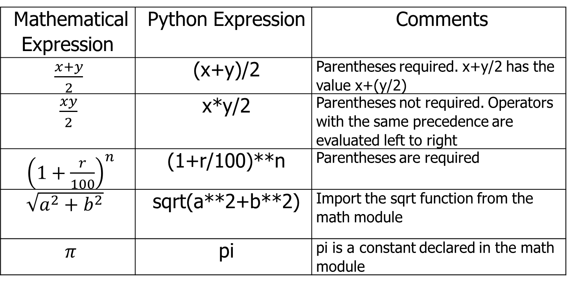
Arithmetic Expression Examples
Mathematical Expression | Python Expression | Comments
$\frac{x+y}{2}$ | (x+y)/2 | Parentheses required. x+y/2 has the value x+(y/2)
$\frac{xy}{2}$ | x*y/2 | Parentheses not required. Operators with the same precedence are evaluated left to right
${\left(1+\frac{r}{100}\right)}^{n}$ | (1+r/100)**n | Parentheses are required
$\sqrt{a^{2}+b^{2}}$ | sqrt(a**2+b**2) | Import the sqrt function from the math module
$π$ | pi | pi is a constant declared in the math module

Slide 6
Balanced Parentheses
The following formula
((a+b)*t/2*(1-t)
is not correct. The parentheses are not balanced.
Check: count from left to right starting at 0, add 1 for a left bracket, subtract 1 for a right bracket. In this case,
0 1 2 1 2 1
What about (a+b))*(t/2*(1-t)?
0 1 0 -1 0 1 0
The parentheses are balanced if and only if
the count is always non-negative and
the final count is 0
Notes:
0 1 0 -1 0 1 0

Slide 7
Examples of Function Calls
price = 124
rate = 0.173
tax1 = round(price*rate, 2) # price*rate = 21.452
# round to 2 decimal places
tax2 = round(price*rate)
# round to the nearest integer
# The value of tax1 is 21.45. The value of tax2 is 21.
best = min(price1, price2, price3, price4)
# The function min has an arbitrary number of arguments
Notes:
125*0.173=21.625

Slide 8
Standard Library
All Python systems have the standard library
The standard library contains built in functions that can be used immediately in your programs, e.g. abs, float, int, input, min, max, print, round …
The standard library also contains a math module with functions such as sqrt, cos, sin, tan, exp, etc.
See PFE Appendix D
Notes:
exp(x) = e**x
cos(pi)=-1.0 in radians

Slide 9
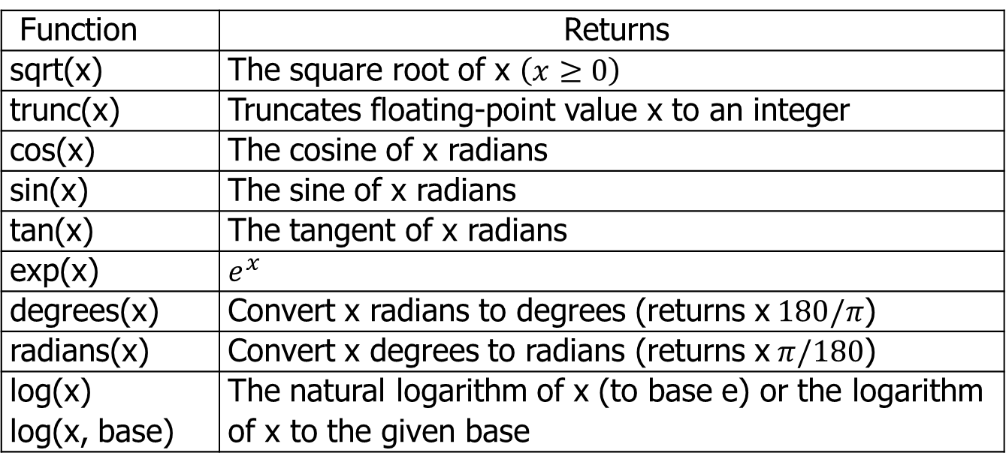
Selected Functions in the Math Module
Function | Returns
sqrt(x) | The square root of x $\left(x≥0\right)$
trunc(x) | Truncates floating-point value x to an integer
cos(x) | The cosine of x radians
sin(x) | The sine of x radians
tan(x) | The tangent of x radians
exp(x) | $$e^{x}$$
degrees(x) | Convert x radians to degrees (returns x$180/π$)
radians(x) | Convert x degrees to radians (returns x$π/180$)
log(x) log(x, base) | The natural logarithm of x (to base e) or the logarithm of x to the given base

Slide 10
Obtaining a math Module Function
To use e.g. sqrt, put this statement at the top of the program
from math import sqrt
Multiple functions can be obtained using a single statement
from math import sqrt, sin, cos
To obtain everything use
from math import *
See PFE Appendix D, math Module

Slide 11
Exercise
Write the following mathematical expressions in Python
$s=s_{0}+v_{0}t+\frac{1}{2}gt^{2}$
$G=4π^{2}\frac{a^{3}}{p^{2}\left(m_{1}+m_{2}\right)}$
$FV=PV{\left(1+\frac{INT}{100}\right)}^{YRS}$
$c=\sqrt{a^{2}+b^{2}−2a b\cos\left(γ\right)}$

Slide 12
Roundoff Errors
price = 4.35
quantity = 100
total = price * quantity # Should be 100 * 4.35 = 435
print(total) # Prints 434.99999999999994
# The number 4.35 cannot be represented exactly as a
# binary floating point number

Slide 13
User Input
first = input("Enter your first name: ")
# The input function displays the string argument (prompt) in
# the console window and places the cursor on the same line,
# immediately following the string.
Enter your first name: _
# The program waits until the user types a string followed
# by Enter. The string is stored as the value of first.
Notes:
Prompt: A symbol on a display screen indicating that the computer is waiting for input. Once the computer has displayed a prompt, it waits for you to enter some information. Generally, it will wait forever, but some programs have built-in time-outs that cause the program to continue execution after it has waited a specified amount of time.

Slide 14
Numerical Input
userInput = input("Please enter the number of bottles: ")
bottles = int(userInput)
# The input function reads in a string and returns the string to # the calling program. The function int converts the string to # an integer.
bottles = int(input("Please enter the number of bottles: "))
userInput2 = input("Enter price per bottle: ")
price = float(userInput2)
# The function float converts the string to a floating point value.
price = float(input("Enter price per bottle: "))

Slide 15
The Function int
print(int("5"))
# print 5
print(int("test"))
# invalid literal for int
print(int(7.6))
# truncate to 7, not round to 8
print(int(-7.6))
# truncate to -7, not round to -8
print(int("5.6"))
# invalid literal for int, one-step transformation only
Notes:
int() can turn a float into an int, or a string into an int, but not first string to float then float to int.

Slide 16
Description of int in Appendix D
The Python Standard Library
Built-in Functions
int(x)
This function converts a number or string to an integer.
Parameter: x A string or numerical value
Returns: The new integer object

Slide 17
The Function float
print(float("5"))
# print 5.0
print(float("7.6"))
# print 7.6
print(float(7.6))
# print 7.6
print(float("test"))
# ValueError: could not
# convert string to float
print(float("3E2"))
# print 300.0
print(float("3e2"))
# print 300.0
Remark: print(int("5.6")) error, but print(float("5")) works

Slide 18
Vending Machine
Write a program that simulates a vending machine.
A customer selects an item for purchase and inserts a bill into the vending machine. The vending machine dispenses the purchased item and gives change.
Assumption 1: only one bill is inserted to purchase an item
Assumption 2: only one item is purchased at a time
Assumption 3: the bill is no less than the purchase price
Assumption 4: all item prices are multiples of 25 cents
Assumption 5: the machine gives all change in
dollar coins (1 dollar) and quarters (25 cents).
Compute how many coins of each type to return

Slide 19
Preliminaries
Step 1: identify inputs and outputs.
Step 2: Work out an example by hand, e.g. the item costs $2.25 and a $5 bill is inserted.
Step 3: Write pseudo code for computing the answers.

Slide 20
Coding
Step 4: Declare the variables and constants that are needed.
Step 5: Turn the pseudo code into Python statements.
Step 6: Provide input and output.
Step 7: Write the program.

