Slide 1
Introduction to Programming
Department of Computer Science and Information Systems
Lecturers: Tingting Han and Steve Maybank
sjmaybank@dcs.bbk.ac.uk
Autumn 2019 and Spring 2020
Week 9: Functions

Slide 2
Exercise 2: Vowels
Input a string, print out the characters in a vertical line, then count the number of lowercase vowels in the string.
Birkbeck College, U. London
2

Slide 3
Exercise 2: code
s = input("Enter a string:")
n = 0
for letter in s :
print(letter)
if letter == "a" or letter == "e" or letter == "i" or letter == "o" or letter == "u" :
n = n+1
print("The number of vowels is", n)
Birkbeck College, U. London
3

Slide 4
Exercise 2: code
s = input("Enter a string:")
n = 0
for letter in s :
print(letter)
if letter == "a" or letter == "e" :
n = n+1
elif letter == "i" or letter == "o" or letter == "u" :
n = n+1
print("The number of vowels is", n)
Birkbeck College, U. London
4

Slide 5
Exercise 2: code
s = input("Enter a string:")
n = 0
for letter in s :
print(letter)
if letter in "aeiou" :
n = n+1
print("The number of vowels is", n)
Birkbeck College, U. London
5

Slide 6
Exercise 3: number properties
Write a program to input a non-empty list of strictly positive integers from the keyboard.
The end of the input is indicated by 0.
The program then prints out the following numbers.
The average
The smallest of the values
The largest of the values
The range
Birkbeck College, U. London
6

Slide 7
Exercise 3: code(1)
number = int(input("Enter a strictly positive integer (0 to finish): "))
count = 1 # number of inputs
total = number # total of the inputs
mx = number # maximum value
mn = number # minimum value
while number > 0 :
number = int(input("Enter a strictly positive integer (0 to finish): "))
if number != 0 :
count = count + 1
total = total + number
mx = max(mx, number)
mn = min(mn, number)
print("The average value is", total/count)
Birkbeck College, U. London
7

Slide 8
Exercise 3: code(2)
print("The average value is", total/count)
print("The smallest value is", mn)
print("The largest value is", mx)
print("The range is", mx-mn+1)
Birkbeck College, U. London
8

Slide 9
Functions are Tools
Name What it does Input Output
To use a tool, we don't need to know how it is implemented.
To build a tool, we do need to know how it's implemented.
Notes:
printer
coinPresser
drawFromHat is a randomised function
timer

Slide 10
Functions
A function is a sequence of instructions with a name.
When a function is called, the instructions are executed.
When the execution of the instructions is complete, the function may return a value to the calling program.
PFE Section 5.1
10

Slide 11
Example
price = round(6.8275, 2)
# The function round is called with arguments 6.8275 and 2.
# round returns the number 6.83, which becomes the value of price.
# The computations within round are hidden from the calling program.
PFE Section 5.1
11

Slide 12
Function Definition
def cubeVolume(sideLength) : # function header
volume = sideLength**3 # function body
return volume # function body
# name of function: cubeVolume
# Name of parameter variable: sideLength
# def and return are reserved words
# return exits the function and returns the result
PFE Section 5.2
12
Notes:
A parameter is a variable in a method definition. When a method is called, the arguments are the data you pass into the method's parameters.

Slide 13
Compile Time Error
print(cubeVolume(10)) #when function is used/called
def cubeVolume(sideLength) : #when function is created/defined
volume = sideLength**3
return volume
# The function cubeVolume is called before it is known to the program
PFE Section 5.2
13

Slide 14
Calling a Function from Within a Function
def main() : #main() is defined
result = cubeVolume(2)
print("A cube with side length 2 has volume", result)
# The definition of cubeVolume is not required when main is defined
def cubeVolume(sideLength) : #cubeVolume() is defined
volume = sideLength**3
return volume
main() #main() is called, cubeVolume() is called
# The definition of cubeVolume is required when main is called
JFE Section 5.2
14
Notes:
def main() : #main() is defined
result = cubeVolume(2)
print("A cube with side length 2 has volume" ,result)
main()
def cubeVolume(sideLength) :
volume = sideLength**3
return volume
Compile time error

Slide 15
Compile Time Error
def main() : #main() is defined
result = cubeVolume(2)
print("A cube with side length 2 has volume", result)
# The definition of cubeVolume is not required when main is defined
main() #main() is called, cubeVolume() is called
# The definition of cubeVolume is required when main is called
def cubeVolume(sideLength) : #cubeVolume() is defined
volume = sideLength**3
return volume
JFE Section 5.2
15
Notes:
def main() : #main() is defined
result = cubeVolume(2)
print("A cube with side length 2 has volume" ,result)
main()
def cubeVolume(sideLength) :
volume = sideLength**3
return volume
Compile time error

Slide 16
Function Comments
##
# Computes the volume of a cube.
# @param sideLength the length of a side of the cube
# @return the volume of the cube
#
def cubeVolume(sideLength) :
volume = sideLength**3
return volume
Function comments explain the purpose of the function and
the meaning of the parameter variables and the return value.
PFE Section 5.2
16

Slide 17
Parameter Passing
When a function is called, variables are created for receiving the function’s arguments.
These variables are called parameter variables or formal parameters.
The values supplied to a function when it is called are the arguments or the actual parameters.
PFE Section 5.3
17

Slide 18
Example
def cubeVolume(sideLength) :
volume = sideLength**3
return volume
result = cubeVolume(2)
# The parameter variable sideLength is created when cubeVolume is called
# sideLength is initialised with the value 2
# The expression sideLength**3 is evaluated, giving 8.
# The value 8 is assigned to the variable volume
# The function returns. All of its variables are removed. The return value 8 is assigned to the variable result.
PFE Section 5.3
18

Slide 19
Multiple Function Calls
def cubeVolume(sideLength) :
volume = sideLength**3
return volume
result1 = cubeVolume(2)
result2 = cubeVolume(10)
# The variables sideLength and volume used in the
# calculation of result1 are discarded.
#New variables are created for the calculation of result2.
PFE Section 5.4
19

Slide 20
Test
def f(x) :
return g(x) + sqrt(h(x))
def g(x) :
return 4 * h(x)
def h(x) :
return x * x + k(x) - 1
def k(x) :
return 2 * (x + 1)
# Evaluate f(2) and g(h(2))
PFE R5.4
20
Notes:
f(2) = g(2)+sqrt(h(2)) === 36+sqrt(9)=39
g(2)=4*h(2) === 36
h(2)=2*2+k(2)-1 === 9
k(2)=2*3=6
g(h(2))=g(9)=4*h(9)===400
h(9)=9*9+k(9)-1===100
k(9)=2*10=20

Slide 21
Cases
def cubeVolume(sideLength) :
if sideLength < 0 : # deal with the exceptional case
return 0
else :
return sideLength**3 # then deal with the usual case
# Alternative definition
def cubeVolume(sideLength) :
if sideLength < 0 :
return 0
return sideLength**3
PFE Section 5.4
21

Slide 22
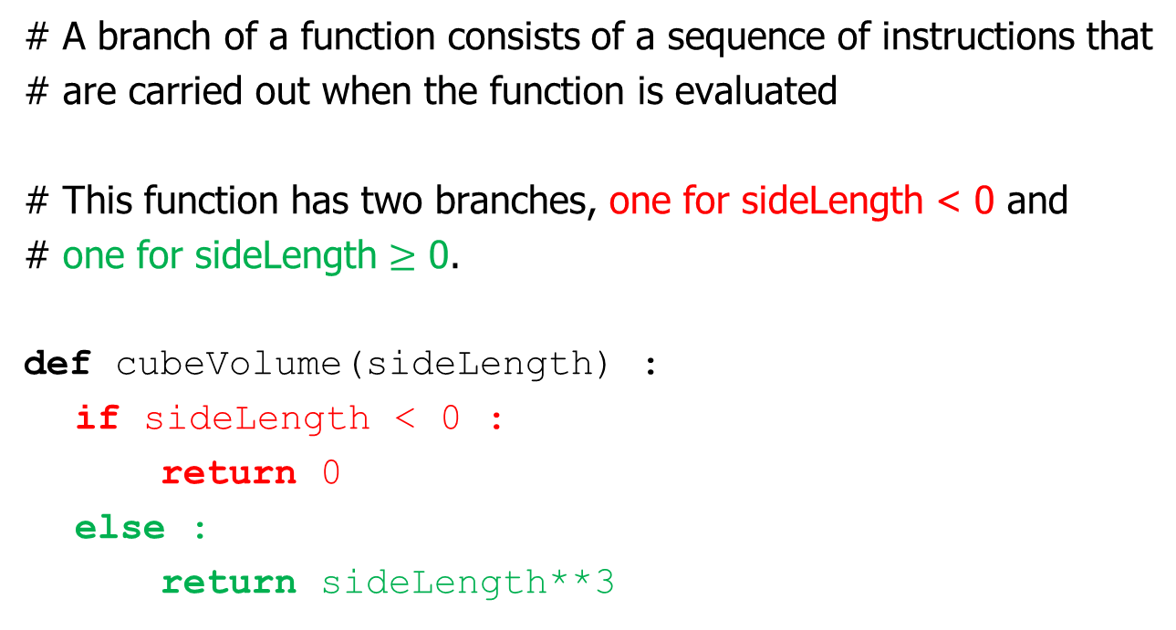
Branches of a Function
# A branch of a function consists of a sequence of instructions that
# are carried out when the function is evaluated
# This function has two branches, one for sideLength < 0 and
# one for sideLength $≥$ 0.
def cubeVolume(sideLength) :
if sideLength < 0 :
return 0
else :
return sideLength**3
PFE Section 5.4
22

Slide 23
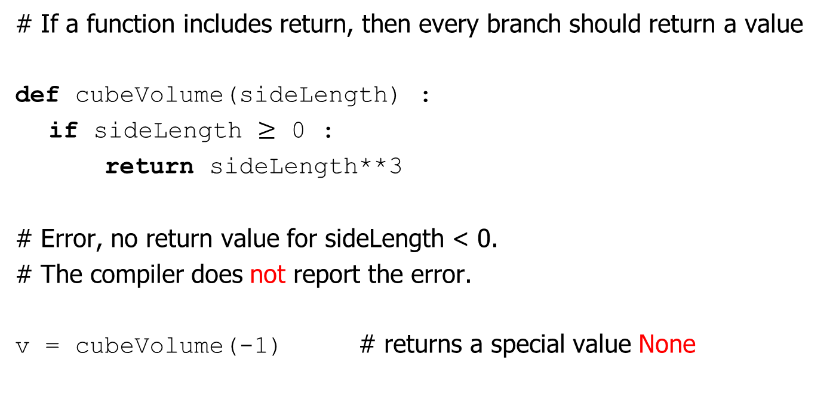
Branches and Return Values
# If a function includes return, then every branch should return a value
def cubeVolume(sideLength) :
if sideLength $≥$ 0 :
return sideLength**3
# Error, no return value for sideLength < 0.
# The compiler does not report the error.
v = cubeVolume(-1) # returns a special value None
PFE Section 5.4
23

Slide 24
Scope
The scope of a variable is the part of the program in which it can be accessed.
A local variable is a variable defined in a function. The scope extends from the line in which it is defined to the end of the function.
def main() :
sum = 0
for i in range(11)
square = i * i
sum = sum + square
print(square, sum)
How many local variables are there? What is the scope of each?
PFE Section 5.8
24
Notes:
3 local variables: sum, i, square.

Slide 25
Scope
The scope of a variable is the part of the program in which it can be accessed.
A local variable is a variable defined in a function. The scope extends from the line in which it is defined to the end of the function.
def main() :
sum = 0 # first line in the scope of the local variable sum
for i in range(11) : # first line in the scope of the local variable i
square = i * i # first line in the scope of the local variable square
sum = sum + square
print(square, sum) # last line in the scope of sum, i, square
# Note: main() has no return value
PFE Section 5.8
25

Slide 26
Stepwise Refinement
+-----+-----------+
| i | i * i * i |
+-----+-----------+
| 1| 1|
| 2| 8|
… …
| 20| 8000|
+-----+-----------+
Divide the task of printing
this table into a sequence
of simpler tasks. (PFE, Ch. 5.7, self check 30)
PFE Section 5.7
26

Slide 27
Solution
+-----+-----------+
| i | i * i * i|
+-----+-----------+
| 1| 1|
| 2| 8|
… …
| 20| 8000|
+-----+-----------+
printSeparator
printHeader
printSeparator
printBody
printSeparator
PFE Section 5.7
27

Slide 28
Solution
def printSeparator():
separator = '+' + '-' * 5 + '+' + '-' * 11 + '+'
print(separator)
def printHeader():
header ='|' + '%5s' % 'i' + '|' + '%11s' % 'i*i*i' + '|'
print(header)
def printBody():
for i in range(1,21):
string = '|' + '%5d' % i + '|' + '%11d' % i**3 + '|'
print(string)
def main():
printSeparator()
printHeader()
printSeparator()
printBody()
printSeparator()
main()
+-----+-----------+
| i | i * i * i|
+-----+-----------+
| 1| 1|
| 2| 8|
… …
| 20| 8000|
+-----+-----------+
PFE Section 5.7
28

Slide 29
Example
Write a function
def repeat(string, n, delim) :
that returns string repeated n times, separated by the
string delim. For example
repeat("ho", 3, ", ")
returns "ho, ho, ho"
(not "ho, ho, ho, " !)
PFE P5.5
29

Slide 30
Solution
def repeat(string, n, delim) :
if n <= 0:
return "n should be greater than 0" #error message
else:
s = string
for i in range(1,n):
s = s + delim + string
return s
def main():
strg = input("Please enter the string to be repeated:")
num = int(input("Please enter the number of times to be repeated:"))
deliminator = input("Please enter the deliminator to separate the strings:")
print(repeat(strg, num, deliminator))
main()
PFE P5.5
30

Slide 31
Alternative Solution
def repeat(string, n, delim) :
if n <= 0:
return "n should be greater than 0" #error message
else:
s = string
s = s + (delim + string) * (n - 1)
# Alternatively, we can write ß
# s += (delim + string) * (n - 1)
return s
def main():
strg = input("Please enter the string to be repeated:")
num = int(input("Please enter the number of times to be repeated:"))
deliminator = input("Please enter the deliminator to separate the strings:")
print(repeat(strg, num, deliminator))
main()
PFE P5.5
31

