Slide 1
Introduction to Computer Systems
Department of Computer Science and Information Systems
Lecturer: Steve Maybank
sjmaybank@dcs.bbk.ac.uk
Spring 2020
Week 1a: History of Computing

Slide 2
Hardware for Evaluating 1+2
Brain
Abacus – rods and beads
Mechanical – rods and gears
Electromechanical – electromagnets open and close switches
Vacuum tubes
Transistors and integrated circuits

Slide 3
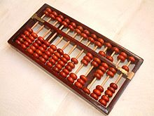
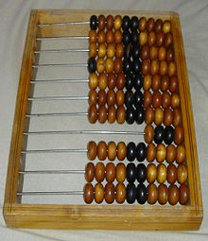
Abacus
Chinese abacus
Russian abacus
https://en.wikipedia.org/wiki/Abacus

Slide 4
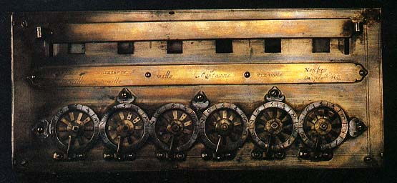
Pascal’s Calculator: the Pascaline
Addition and
subtraction
only.
Image from http://www.tcf.ua.edu/AZ/ITHistoryOutline.htm
See “How the Pascaline works” on You Tube

Slide 5
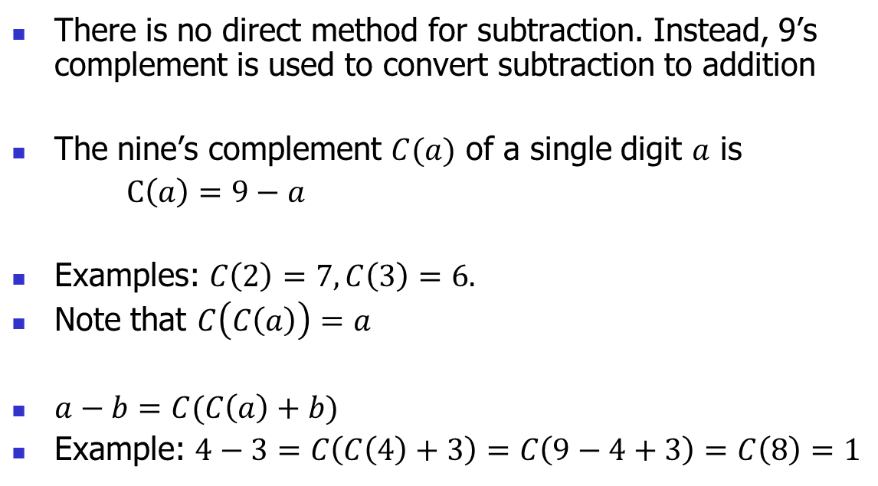
Subtraction Using the Pascaline
There is no direct method for subtraction. Instead, 9’s complement is used to convert subtraction to addition
The nine’s complement $C(a)$ of a single digit $a$ is
$C\left(a\right)=9−a$
Examples: $C\left(2\right)=7, C\left(3\right)=6.$
Note that $C\left(C\left(a\right)\right)=a$
$a−b=C(C\left(a\right)+b)$
Example: $4−3=C\left(C\left(4\right)+3\right)=C\left(9−4+3\right)=C\left(8\right)=1$
See http://ds-wordpress.haverford.edu/bitbybit/bit-by-bit-contents/
chapter-one/1-7-pascal-and-the-pascaline/

Slide 6
Difference Engine
Early computer for squaring numbers, and much more. Numerical results printed out in the form of tables.
Designer: Charles Babbage (1791-1871)
1821: plans for a Difference Engine.
1832: partially built by Joseph Clement.
1834: plans for a more advanced computer, the programmable Analytical Engine. Never built.
See http://en.wikipedia.org/wiki/Charles_Babbage

Slide 7
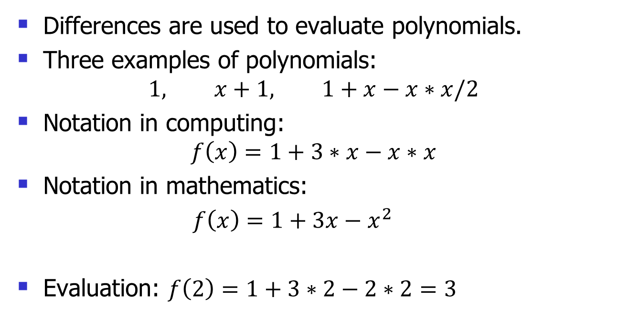
Why Differences?
Differences are used to evaluate polynomials.
Three examples of polynomials:
$$1, x+1, 1+x−x∗x/2$$
Notation in computing:
$$f\left(x\right)=1+3∗x−x∗x$$
Notation in mathematics:
$f\left(x\right)=1+3x−x^{2}$
Evaluation: $f\left(2\right)=1+3∗2−2∗2=3$

Slide 8
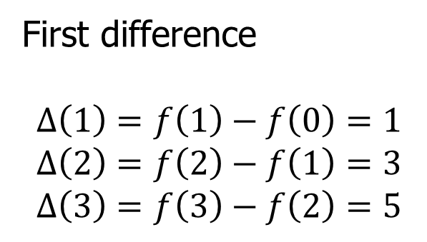
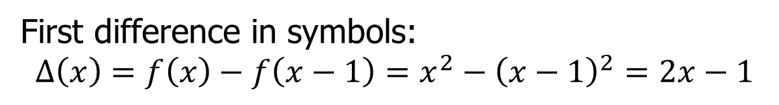
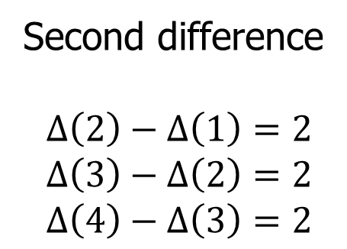
Example of Differences
$f\left(x\right)=x^{2}$
First difference
$$∆\left(1\right)=f\left(1\right)−f\left(0\right)=1$$
$$∆\left(2\right)=f\left(2\right)−f\left(1\right)=3$$
$$∆\left(3\right)=f\left(3\right)−f\left(2\right)=5$$
Second difference
$$∆\left(2\right)−∆\left(1\right)=2$$
$$∆\left(3\right)−∆\left(2\right)=2$$
$$∆\left(4\right)−∆\left(3\right)=2$$
First difference in symbols:
$$Δ\left(x\right)=f\left(x\right)−f\left(x−1\right)=x^{2}−{\left(x−1\right)}^{2}=2x−1$$

Slide 9
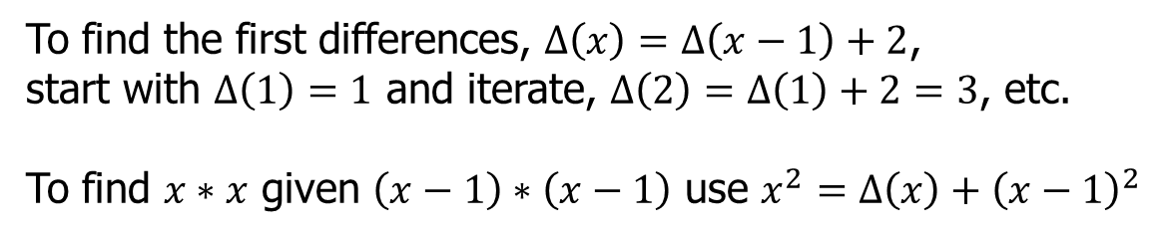

Evaluation of $x^{2}$ Using Differences
x | x*x | 1st difference | 2nd difference
0 | 0
1 | 1 | 1
2 | 4 | 3 | 2
3 | 9 | 5 | 2
4 | 16 | 7 | 2
5 | 25 | 9 | 2
To find the first differences, $Δ\left(x\right)=Δ\left(x−1\right)+2$,
start with $Δ\left(1\right)=1$ and iterate, $Δ\left(2\right)=Δ\left(1\right)+2=3$, etc.
To find $x∗x$ given $\left(x−1\right)∗\left(x−1\right)$ use $x^{2}=Δ\left(x\right)+{\left(x−1\right)}^{2}$

Slide 10

Why Polynomials?
Polynomials are used to approximate more complicated functions, e.g. if $x$ is small, $\log\left(1+x\right)≈x−x^{2}/2$

Slide 11
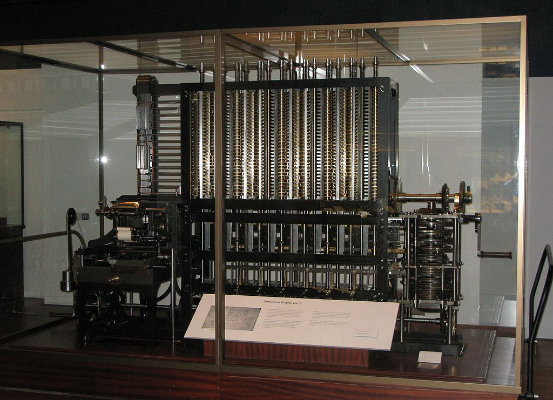
Modern Construction of a Difference Engine
Difference engine
constructed
from
Babbage’s
designs
by the Science
Museum
https://en.wikipedia.org/wiki/Difference_engine

Slide 12
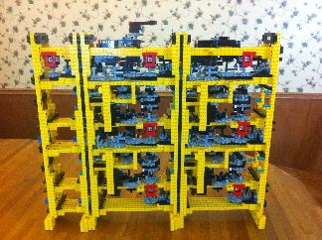
Lego® Version of the Difference Engine
Built by
Andrew
Carol
https://www.i-programmer.info/news/82-heritage/1265-lego-difference-engine.html

Slide 13
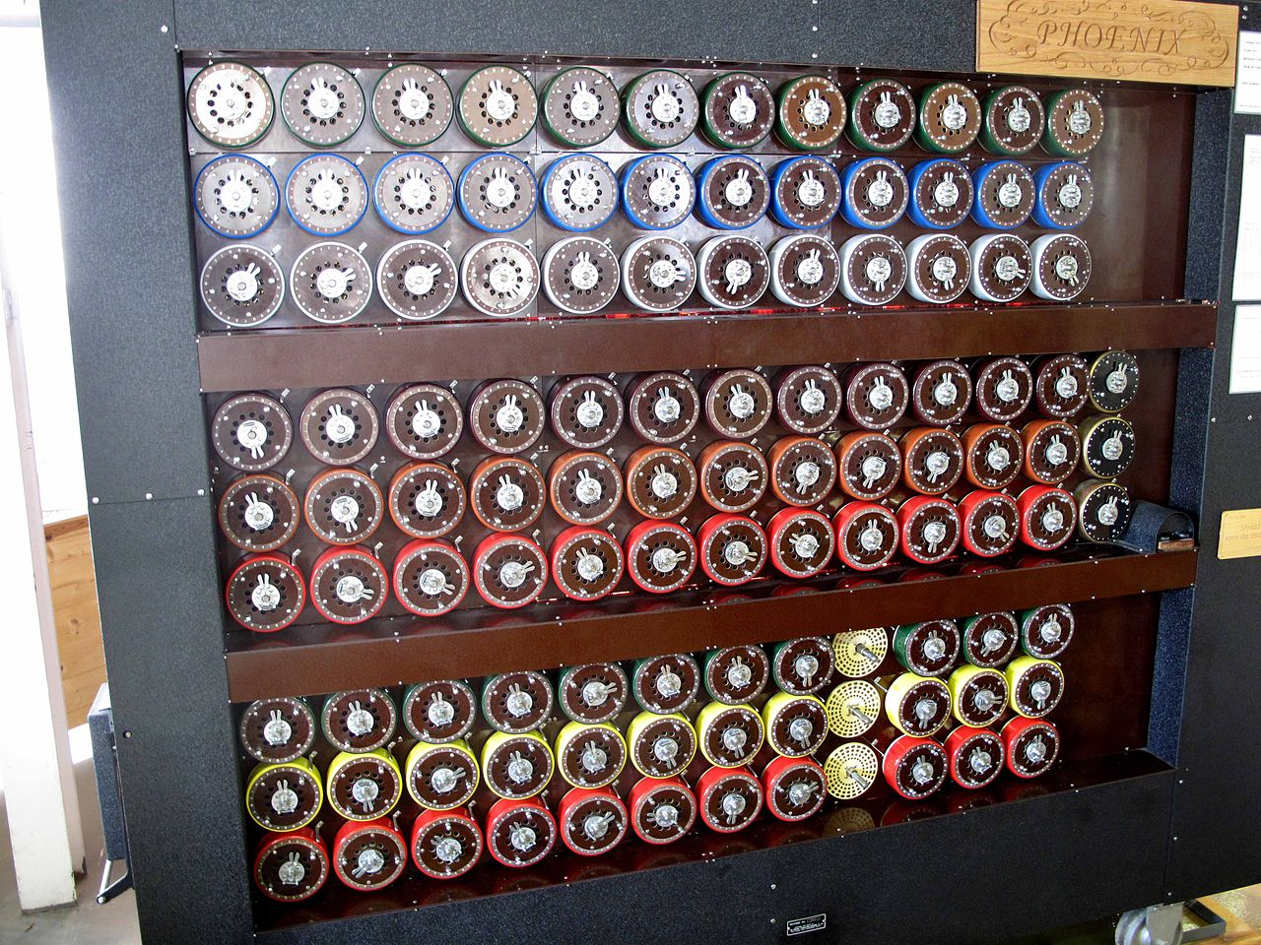
Code Breaking Machine
Replica of the “Bombe”
used at Bletchley Park
Original design (1939):
Alan Turing
Gordon Welchman
Electromechanical, specialised for breaking the Enigma code
https://en.wikipedia.org/wiki/Cryptanalysis_of_the_Enigma

Slide 14
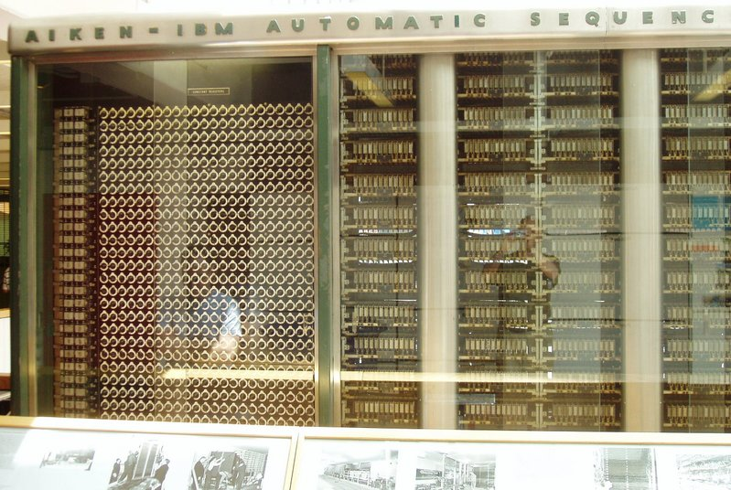
Electromechanical Computer
1st fully automatic computer.
Vol16x2.4x0.6 m³, weight 4500 Kg.
Instructions read from punched paper.
Store: 72 nums. of 23 decimal digits.
Speed: + or - 0.3 s., * 6 s., / 15.3 s.
http://en.wikipedia.org/wiki/Harvard_Mark_1
H. Aiken, 1944

Slide 15
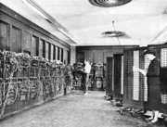
ENIAC
18,000 vacuum tubes
Vol 30x2.4x0.9 m³, Weight 27000 Kg
Data input: card reader.
Volatile store: twenty 10 digit decimal nos.
Read only store: 100 nos.
Programming: rewire
Speed: + or – 0.2 ms,
* 3 ms, / 25 ms.
http://en.wikipedia.org/wiki/ENIAC
J. Presper-Eckert and J. Mauchley

Slide 16
Computing at Birkbeck
1945: Andrew Booth recruited by J.D. Bernal to work on mathematical methods for inferring crystal structure from X-rays.
1946-: builds series of computers, Automatic Relay Computer (ARC), ARC2, SEC, …
1957: establishes Department of Numerical Automation at Birkbeck
See http://www.dcs.bbk.ac.uk/50years/50yearsofcomputing.pdf

Slide 17
Computing at Birkbeck
MSc student Norman Kitz
working on the SEC (Simple
Electronic Computer) at
Birkbeck (1949).
http://www.dcs.bbk.ac.uk/
50years/50yearsofcomputing.pdf

Slide 18
Computing Game
Tom has a game in which he pretends to be a computer…

Slide 19
Equipment for the Game
10
5
1
12
-3
-1
11
0
1
2
3
4
5
6
A set of boxes
Each box has a name: 0, 1, 2, …
Each box contains a piece of paper with a single
number on it, e.g. box 0 contains 10

Slide 20
Instructions
Tom carries out instructions such as:
Add the number in box 0 to the number in box 2,
then put the result in box 2, i.e. make the result
the new number in box 2.
Subtract the number in box 1 from the number in
box 0. Put the result in box 0.
Multiply the number in box 1 with the number in
box 3. Put the result in box 4.

Slide 21
Observations
The computer consists of a memory (the boxes), a
device for changing the contents of the memory (Tom)
and a list of instructions.
The instructions are simple and there are only a few types
(so far add, subtract and multiply).
The instructions are carried out one at a time.
There is no limit to the number of instructions which are
carried out (Tom never gets tired).

