Slide 1
Introduction to Programming
Department of Computer Science and Information Systems
Lecturer: Steve Maybank
sjmaybank@dcs.bbk.ac.uk
Autumn 2019 and Spring 2020
Week 2b: Review of Week 1, Variables

Slide 2
My First Program
# My first program
print("Hello World!")
When the above program is run in IDLE the string
"Hello World!" appears in the shell screen

Slide 3
Commentary
# My first program
print("Hello World!")
The function print is called with the argument "Hello World!"
The string "Hello World!" is written to the shell
The statements within the function print are hidden
The function print is in the Python Standard Library, PFE Appendix D

Slide 4
Strings
A string is a sequence of characters, e.g. "Hello”.
The quotes " " are a sign that a string is present. The quotes are not themselves part of the string.
What if we want to print " in a string? E.g., He said "yes".
print("He said \" yes\". ")
print('He said " yes". ')
A string is not interpreted further, e.g. given "Hello" the compiler does not check to see if Hello is the name of a variable.
Notes:
print("He said \"I can fly\".")

Slide 5
Errors
Compile time errors: syntax errors found by the compiler, e.g.
print)3)
Run time errors (exceptions): errors which are not found by the compiler, but which prevent the program from running to completion, e.g.
print(1/(2-2))
Run time errors (but not exceptions): the program compiles and runs but the output is not what is intended, e.g.
print("Hello Worrld!")

Slide 6
Investment Problem
You put £10,000 into a bank account that earns 5% interest per year.
How many years does it take for the account balance to be double the original?
(PFE, Section 1.7)

Slide 7
Solution to Investment Problem
Initial balance:
£10000
Interest rate:
5% per year
Interest earned after 1 year:
10000*5/100 = 500
Balance after 1 year:
initial balance + interest = 10000+500 = 10000*1.05
Balance after two years:
10000*1.05*1.05
Balance after three years:
10000*1.05*1.05*1.05
Continue until the balance is
at least £20000
You put £10,000 into a bank account that earns 5% interest per year.
How many years does it take for the account balance to be double the original?

Slide 8
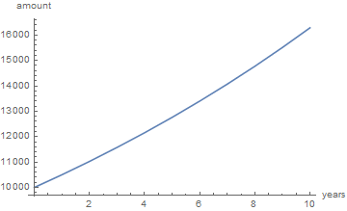
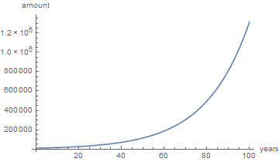
Graphs of the Balance
Graph for 10 years
Graph for 100 years

Slide 9
Algorithms
An algorithm is a sequence of steps that is
unambiguous
executable
terminating

Slide 10
Ambiguity
Notes:
Iggy Pop, the Stooges

Slide 11
Ambiguity
Notes:
Iggy Pop, the Stooges

Slide 12
Ambiguity
Notes:
Iggy Pop, the Stooges

Slide 13
Ambiguity
Natural languages are not accurate
If it is cold, put on coat.
Algorithms should be unambiguous
If it is less than 10 degrees, put on coat.

Slide 14
Executable
A white flower
Nonexecutable!
A statement has to do something
Pick a white flower
Do the action for -2 times
Nonexecutable!
Something that can be done by the program
Do the action for 2 times
Notes:
tracker interest rate
fixed rate

Slide 15
Terminating
The purpose of an algorithm is to deliver an answer to a problem.
If you have to wait infinitely long to get the answer, it is less attractive.
Please wait while your program runs…
Notes:
The purpose of an algorithm is to deliver an answer to a problem. If you have to wait infinitely long to get the answer, it is less attractive. Useful algorithms must enjoy two fundamental properties: correctness and termination. In the context of the Theory of Computability, the answer is not the main focus, though.

Slide 16
Algorithms
An algorithm is a sequence of steps that is
unambiguous
executable
terminating
The above pseudocode solution to the investment problem is an algorithm.
It terminates because the balance increases by at least £500 each year. Thus
number of years <=(20000-10000)/500 = 20

Slide 17
Program
print(10000*1.05*1.05*1.05)
# What does this line compute?
# Include additional factors 1.05 until a number greater # than or equal to 20000 is printed.
# The strategy is crude but it works.

Slide 18
Variables
A variable is a storage location in a computer program
Each variable has a name and it holds a value
Problem: does a six pack of 12 ounce drink cans contain more liquid than a two litre bottle?
Appropriate names of variables:
cansPerPack
CAN_VOLUME
BOTTLE_VOLUME

Slide 19
Assignment of a Value to a Variable
cansPerPack = 6 # assignment statement
# Left hand side: the name of a variable
# Right hand side: a value for the variable
print(cansPerPack)
# the value 6 of the variable cansPerPack will
# appear in the shell
cansPerPack = 8
# the previous value 6 is overwritten

Slide 20
Alternative Assignment Statement
cansPerPack = cansPerPack+2
# 1) Take the current value 8 of the variable cansPerPack
# 2) Evaluate the right hand side of the above statement:
# 8+2 = 10
# 3) Assign the value 10 to the variable cansPerPack
Notes:
What is the current value of the variable? What is the value of the variable after the assignment?

Slide 21
Creation of a Variable
If cansPerPack is used for the first time in a statement such as
cansPerPack = 6
then the variable cansPerPack is created and initialised with the integer value 6.

Slide 22
Undefined Variables
A variable must be created and initialised before use.
print(cansPerPack)
# error if a value has not been assigned to cansPerPack
cansPerPack = 6
# cansPerPack is assigned a value but it is too late.
# The compiler does not look ahead

Slide 23
Number Types
Number type: determines how a number is represented and the operations that can be carried out with that number.
E.g. the int number type and the float number type.
int: any whole number with no fractional part
e.g. -1, 0, 1
float: any decimal fraction
e.g. -1.52, 3.4, - 9.400
e.g. 0.0, 2.0, -3.0
Operations: addition, multiplication, division, etc.

Slide 24
Number Literals
A number literal is a number that appears explicitly in a program, e.g.
q = 5 # What type is the value of q?
# 5 is a number literal of type int
q = 3.5 # What type is the value of q now?
# 3.5 is a number literal of type float
# the value 5 is overwritten with the value 3.5 without error
q = "test" # What type is the value of q now?
# "test" is a string, not a number
# the value 3.5 is overwritten without error (not recommended)

Slide 25
Examples of Number Literals
Number
6
-6
0
0.5
1.0
1E6
2.96E-2
100,000
3 1/2
Type Comment
int An integer has no fractional part
int Integers can be negative
int Zero is an integer
float A number with a fractional part has type float
float An integer with a fractional part .0 has type float
float A number in exponential notation: 1*10⁶ or 1000000.
Numbers in exponential notation always have type float.
float Negative exponent: $2.96×{10}^{−2}=2.96/100=0.0296$
Error: do not use a comma as a decimal separator
Error: Do not use fractions; use decimal notation: 3.5
Notes:
Scientific notation is the way that scientists easily handle very large numbers or very small numbers. For example, instead of writing 0.0000000056, we write 5.6 x 10⁻⁹.

Slide 26
Names of Variables
Names must start with a letter or underscore (_).
The remaining characters must be letters, numbers or underscores
_____, 3letters, _3_3_3, rat^2, tot40_3, can volume
Names are case sensitive
canVolume and canvolume
Reserved words cannot be used, see PFE Appendix C
class, from, import, in, lambda, pass, return, with, yield, …

Slide 27
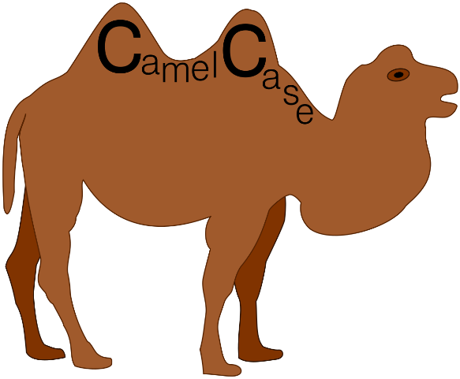
Recommended but not Obligatory
If the value of the variable is significant and does not change, then use only capital letters and underscores in the name, e.g. BAKERS_DOZEN
Otherwise, begin names of variables with a lower case letter, e.g. cansPerPack
Use descriptive names, e.g. cansPerPack rather than cpp
Use capital letters to mark word boundaries, e.g. cansPerPack – Camel naming

Slide 28
Names of Variables
Name of Variable | Comment
canVolume1
Names of variables consist of letters, numbers and underscores
x
Legal, but a more descriptive name is often better
CanVolume
Legal, but violates the convention that names of variables should begin with a lower case letter
6pack
Error: names of variables cannot start with a number
can volume
Error: names of variables cannot contain spaces
class
Error: names of variables cannot be reserved words
ltr/fl.oz
Error: symbols such as / or . cannot be used
Notes:
Error: names of variables cannot contain spaces
Error: names of variables cannot be reserved words
Error: symbols such as / or . cannot be used

Slide 29
Review Questions
R2.1. What is the value of mystery after this sequence of statements?
mystery = 1
mystery = 1-2*mystery
mystery = mystery+1
R2.2. What is the value of mystery after this sequence of statements?
mystery = 1
mystery = mystery+1
mystery = 1-2*mystery
Notes:
write one's own program and let neighbours work out the results.

Slide 30
Compile Time Errors
Cf. R2.8. Find at least three compile time errors in the following program
int x = 2
print(x, squared is, x*x)
xTripled = xDoubled + x

