Slide 1
Introduction to Programming
Department of Computer Science and Information Systems
Lecturers: Tingting Han and Steve Maybank
sjmaybank@dcs.bbk.ac.uk
Autumn 2019 and Spring 2020
Week 7: if Statement

Slide 2
Revision: Relational Operators
5 > 4
# True
5 >= 7
# False
"9032" < "0AB"
# False
"ABC" <= "AB"
# False
48 == 30+18
# True
"AB" != "ABC"
# True

Slide 3
Revision: Lexicographic Ordering
Given strings s1, s2 such that neither string is a prefix of the other, find the least non-negative value of i such that
s1[i] $≠$ s2[i]
The ordering of s1, s2 is the same as the ordering of s1[i], s2[i]
Example, i = 4 and "h" < "n", therefore "alight"< "aligned"
a | l | i | g | n | e | d
a | l | i | g | h | t
0 | 1 | 2 | 3 | 4 | 5 | 6
What happens if one of the strings s1, s2
is a prefix of the other?

Slide 4
Revision: Boolean Operators
The Boolean operators in Python are and, or and not
and, or and not are used to make new Boolean expressions, e.g.
a or b and c
(a or b) and c a or (b and c)
5 == 0 and 6 == 0
# False
5 == 0 or 5 > 4
# True
not(5 == 0)
# True

Slide 5
Revision: Short Circuit Evaluation
Boolean statements x and y, x or y are evaluated left to right.
Evaluation stops as soon as the truth value of the statement is determined.
Example
False and 3/0
False
True and 3/0
ZeroDivisionError: integer division or modulo by zero
True or 3/0
True
False or 3/0
ZeroDivisionError: integer division or modulo by zero
Notes:
quantity = 0
bargain = (quantity == 0 or price/quantity < 10)

Slide 6
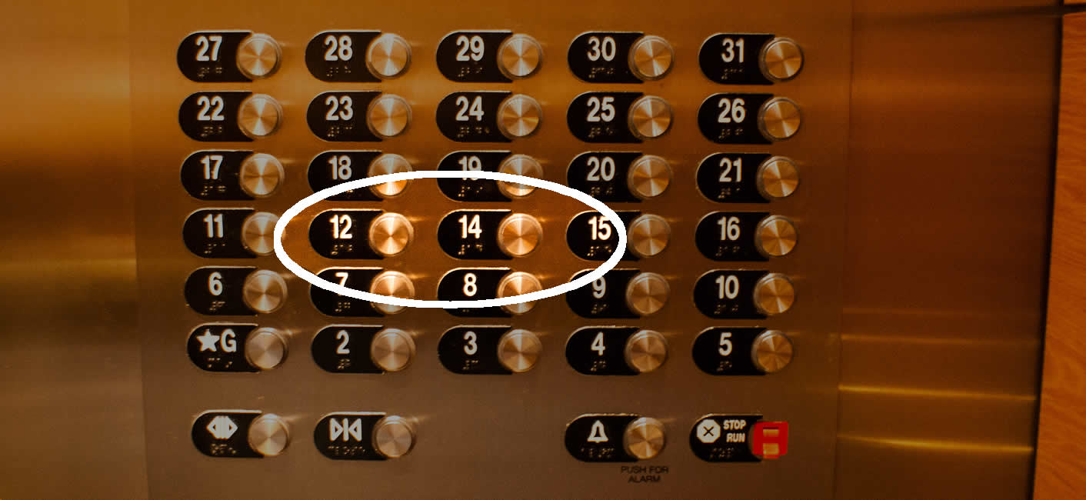
if Statement
Motivation Example – there is no 13th floor!
How to get the actual floor number?
For instance to calculate the distance between the floor and the ground

Slide 7
if Statement
Example – there is no 13th floor!
actualFloor = 0 # define variable
if floor > 13 :
actualFloor = floor - 1
else :
actualFloor = floor

Slide 8
Alternative if Statement
actualFloor = 0 # define variable
if floor > 13 :
actualFloor = floor - 1
else :
actualFloor = floor
Alternative way：
actualFloor = floor
if floor > 13 :
actualFloor = actualFloor - 1

Slide 9
Flow Chart
True
False
floor > 13?
actualFloor = floor-1
actualFloor =floor

Slide 10
Parts of an if Statement
if floor > 13 : # The condition floor > 13 is True or False
actualFloor = floor - 1 # execute only if the condition is True
else :
actualFloor = floor # execute only if the condition is False
# Align if and else
# Indent the statements in each branch

Slide 11
Syntax of if Statements
Version 1
if condition :
statements
Version 2
if condition :
statements_1
else :
statements_2
# The colon indicates the start of a compound statement

Slide 12
Compound Statement
A compound statement contains a header followed by a statement block. Example:
if totalSales > 100.0 : # Colon indicates the header
discount = totalSales * 0.05 # Block of statements
totalSales = totalSales - discount
print("You received a discount of", discount)
# All the statements in the block have the same indentation

Slide 13
An if Statement Example
if floor > 13 :
actualFloor = floor - 1
print("Actual floor:", actualFloor)
else :
actualFloor = floor
print("Actual floor:", actualFloor)
Where could the code be improved?

Slide 14
Avoid Duplication
Avoid
if floor > 13 :
actualFloor = floor - 1
print("Actual floor:", actualFloor)
else :
actualFloor = floor
print("Actual floor:", actualFloor)
and prefer
if floor > 13 :
actualFloor = floor - 1
else :
actualFloor = floor
print("Actual floor:", actualFloor)

Slide 15
What’s the difference?
Program 1
if floor > 13 :
actualFloor = floor - 1
else :
actualFloor = floor
print("Actual floor:", actualFloor)
Program 2
if floor > 13 :
actualFloor = floor - 1
else :
actualFloor = floor
print("Actual floor:", actualFloor)
Indentation plays an important role!

Slide 16
Example 1
The university bookstore has a Kilobyte Day sale every October 24, giving an 8% discount on all computer accessory purchases if the price is less than $128, and a 16% discount if the price is at least $128.
Write a program that asks the cashier for the original price and then prints the discounted price.

Slide 17
Example 1 - Solution
Giving an 8% discount on all computer accessory purchases if the price is less than $128, and a 16% discount if the price is at least $128.
originalPrice = float(input("Please input the original price:"))
if originalPrice < 128.0 :
discountedPrice = originalPrice * (1 – 0.08)
else :
discountedPrice = originalPrice * (1 – 0.16)
print("The discounted price is", discountedPrice)

Slide 18
Avoid "Hard-Wiring"
highPriceThreshold = 128.0
lowDiscountRate = 0.08
highDiscountRate = 0.16
originalPrice = float(input("Please input the original price:"))
if originalPrice < highPriceThreshold :
discountedPrice = originalPrice * (1 – lowDiscountRate)
else :
discountedPrice = originalPrice * (1 – highDiscountRate)
print("The discounted price is", discountedPrice)

Slide 19
Shipping Costs Example
Shipping costs are $5 inside the USA except that to Hawaii and Alaska they are $10. International shipping costs are $10.
First design: use a single if statement to distinguish between the $5 cost and the $10 cost
if(country!="USA" or (country=="USA" and (state == "AK" or state == "HI"))) :
ShippingCost = 10
else :
ShippingCost = 5

Slide 20
Second Design
Shipping costs are $5 inside the USA except that to Hawaii and Alaska they are $10. International shipping costs are $10.
Separate the three branches:
i) inside the USA and in Hawaii or Alaska;
ii) inside the USA and not in Hawaii or Alaska;
iii) outside the USA.
if country == "USA" :
if state == "AK" or state == "HI" :
shippingCost = 10
else :
shippingCost = 5
else :
shippingCost = 10
nested if

Slide 21
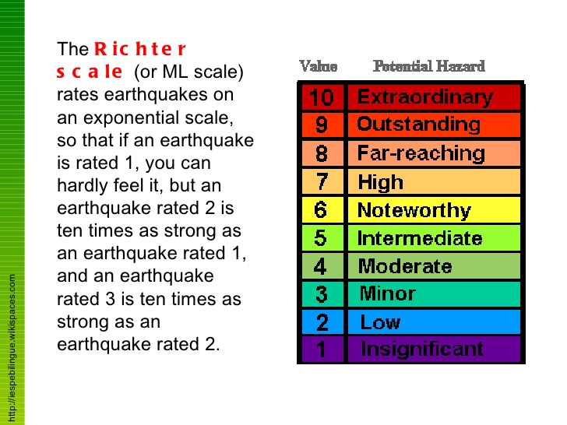
Richter Scale
Notes:
About 540 people were killed and close 8000 injured

Slide 22
Richter Scale
Value | Effect
8 | Most structures fall
7 | Many buildings destroyed
6 | Many buildings considerably damaged, some collapse
4.5 | Damage to poorly constructed buildings
Write a program to print out the
Richter scale using if/else statements.

Slide 23
The if-else Statement
if richter >= 8.0 :
print("Most structures fall")
else:
if richter >= 7.0 :
print("Many buildings destroyed")
else:
if richter >= 6.0 :
print("Many buildings considerably damaged") else:
if richter >= 4.5 :
print("Damage to poorly constructed buildings")
else :
print("No destruction of buildings")
Value | Effect
8 | Most structures fall
7 | Many buildings destroyed
6 | Many buildings considerably damaged, some collapse
4.5 | Damage to poorly constructed buildings

Slide 24
The elif Statement
if richter >= 8.0 :
print("Most structures fall")
elif richter >= 7.0 :
print("Many buildings destroyed")
elif richter >= 6.0 :
print("Many buildings considerably damaged, some collapse")
elif richter >= 4.5 :
print("Damage to poorly constructed buildings")
else :
print("No destruction of buildings")
Notes:
Richter = 9.2, 7.5, 3.0, 4.7

Slide 25
The elif Statement Flowchart
start
True
if
richter >=8.0
print("Most structures fall")
False
elif
True
richter >=7.0
print("Many buildings destroyed")
False
elif
True
richter >=6.0
print("Many buildings considerably ...")
False
True
elif
richter >=4.5
print("Damage to poorly constructed ...")
False
else
print("No destruction...")
finish

Slide 26
Questions
What happens if the order of the tests is reversed? Is this correct?
if richter >= 4.5 :
print("Damage to poorly constructed buildings")
elif richter >= 6.0 :
print("Many buildings considerably damaged, some collapse")
elif richter >= 7.0 :
print("Many buildings destroyed")
elif richter >= 8.0 :
print("Most structures fall")
else :
print("No destruction of buildings")
Value | Effect
8 | Most structures fall
7 | Many buildings destroyed
6 | Many buildings considerably damaged, some collapse
4.5 | Damage to poorly constructed buildings

Slide 27
Questions
Change the order, change the comparison
if richter < 4.5 :
print("No destruction of buildings")
elif richter < 6.0 :
print("Damage to poorly constructed buildings")
elif richter < 7.0 :
print("Many buildings considerably damaged, some collapse")
elif richter < 8.0 :
print("Many buildings destroyed")
else :
print("Most structures fall")
Value | Effect
8 | Most structures fall
7 | Many buildings destroyed
6 | Many buildings considerably damaged, some collapse
4.5 | Damage to poorly constructed buildings

Slide 28
Example
In a game program, the scores of players A and B are stored in variables scoreA and scoreB.
Assuming that the player with the larger score wins.
Write an if/elif sequence that prints out "A won", "B won" or "Game tied".

Slide 29
Example
scoreA = int(input(Please enter player A's score))
scoreB = int(input(Please enter player B's score))
if scoreA > scoreB :
print("A won")
elif scoreB > scoreA :
print("B won")
else:
print("Game tied")

Slide 30
Input Validation
Check user supplied input to see if it has the correct form.
Example: in the elevator simulation let maxFloor be the largest floor number. The following inputs are illegal.
i) 13
ii) 0 or a negative number (in the USA)
iii) any number > maxFloor
iv) Any input not a sequence of digits

Slide 31
Error Messages
floor = int(input("Floor: "))
# if the input is non digital then there is a run time exception
# and the program terminates.
if floor == 13 :
print("Error: there is no 13th floor")
if floor <= 0 or floor > maxFloor :
print("Error: the floor must be between 1 and", maxFloor)

Slide 32
Example Code
floor = int(input("Floor: "))
if floor == 13 :
print("Error: there is no 13th floor")
elif floor <= 0 or floor > maxFloor :
print("Error: the floor must be between 0 and", maxFloor)
else :
actualFloor = floor
if floor > 13 :
actualFloor = actualFloor - 1
← input
← input validation
← rest of the program

Slide 33
Exercise
print("Buy pasta")
if weather == "sunny":
print("Buy salad")
print("Buy olives")
print("Buy wine")
What items will be bought if
1) it is cloudy?
2) it is sunny?

Slide 34
Exercise
Write a program to do the following:
input a mark and print the corresponding grade
90-100: A
80-89: B
70-79: C
60-69: D
50-59: E
<50: F

